Slide 1

Up in the Air
Serverless Computing With Azure Functions

Slide 2
Serverless CQRS
CQRS, DDD and ES?
Serverless?
Serverless CQRS!
What’s next?

Slide 3

Reverse Flash - Sia
Flash - Jan(ek)

Slide 4
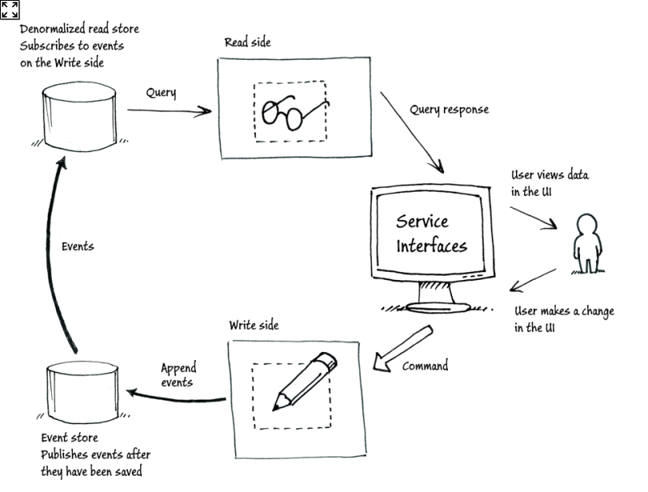
Command and Query Responsibility Segregation

Slide 5
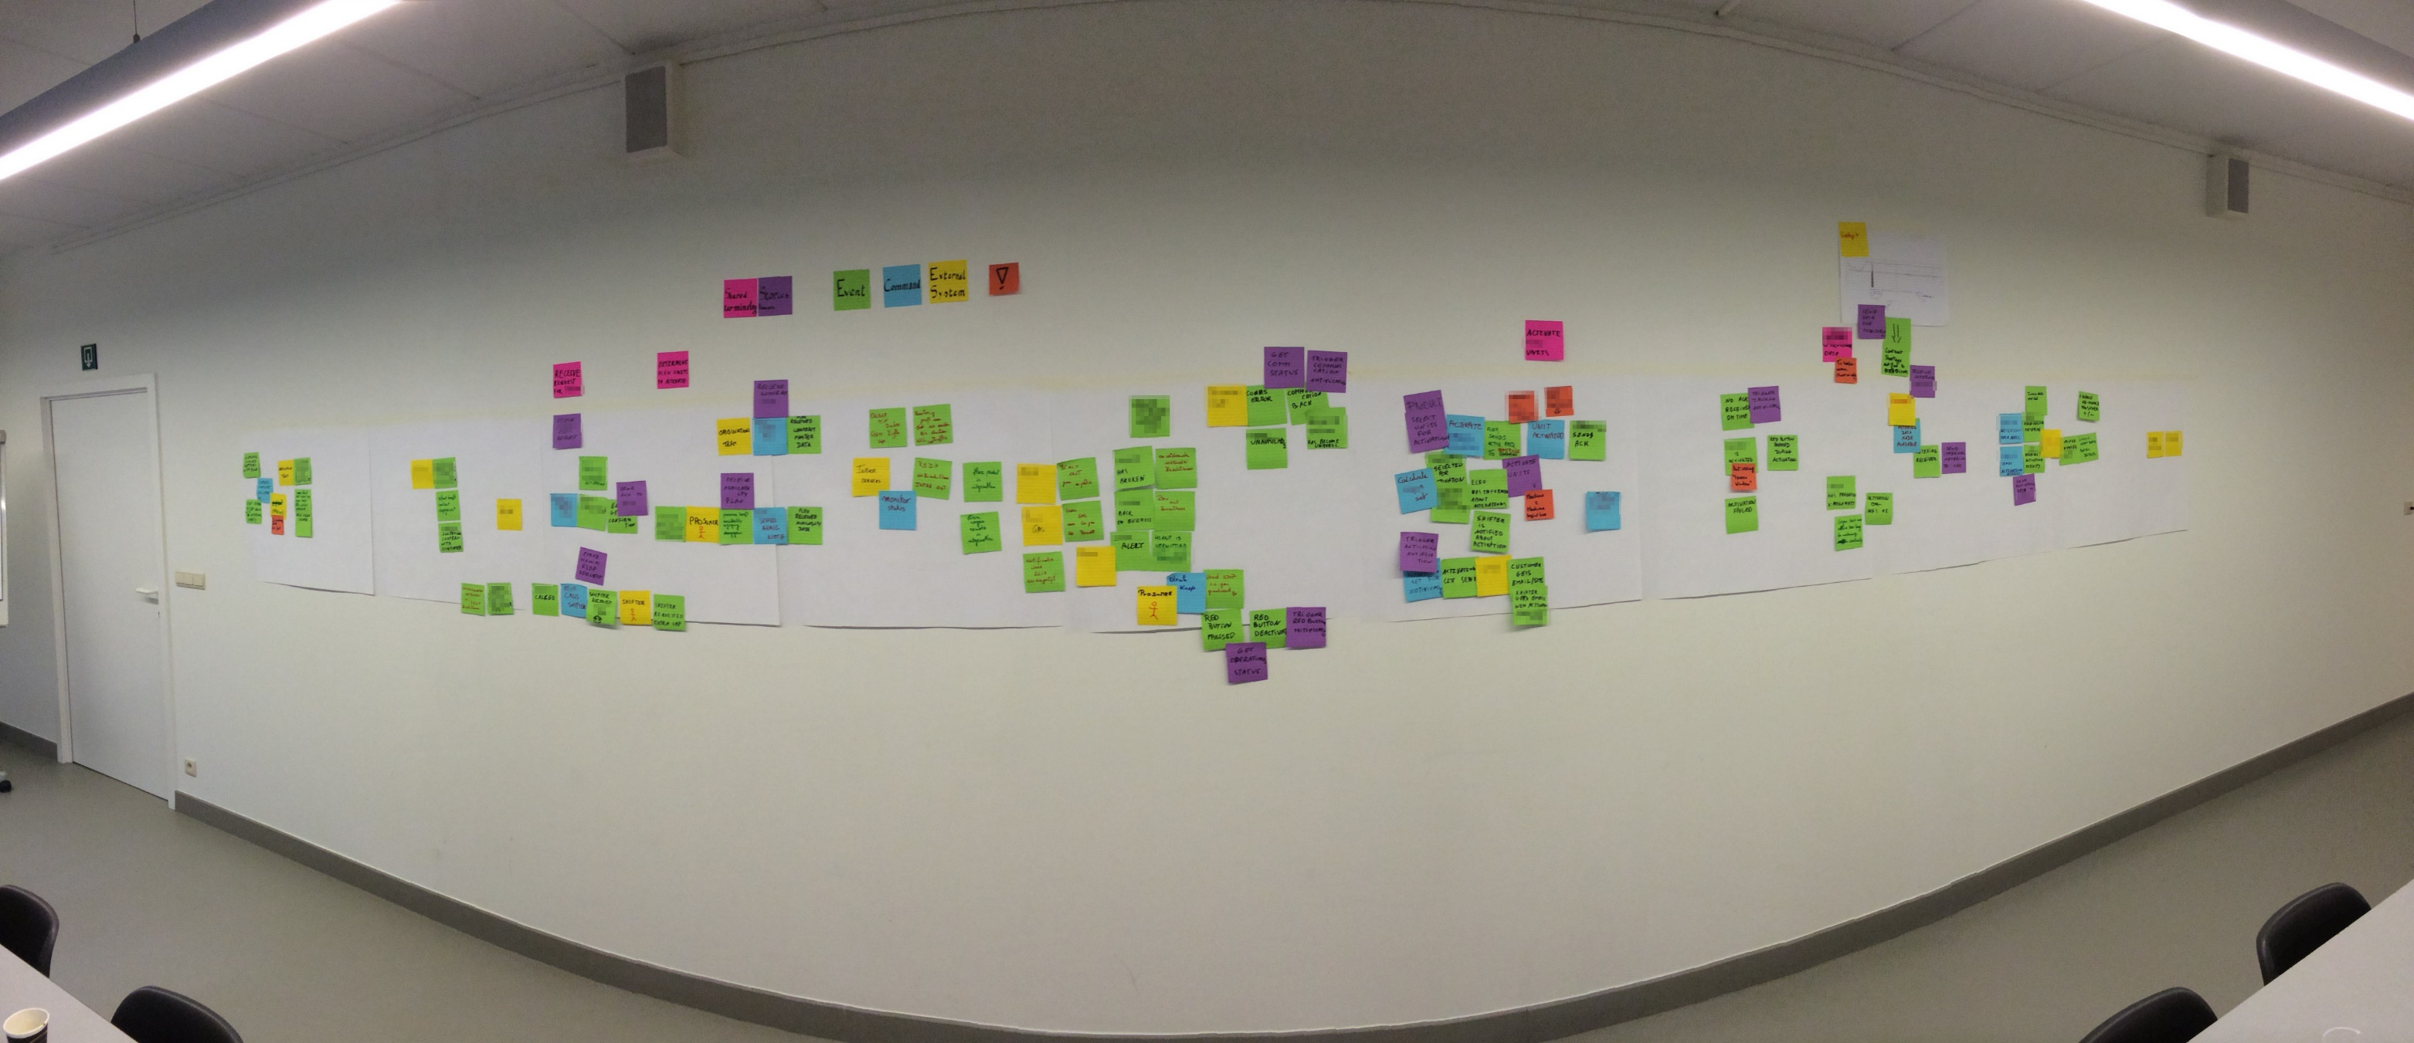
Domain Driven Design

Slide 6
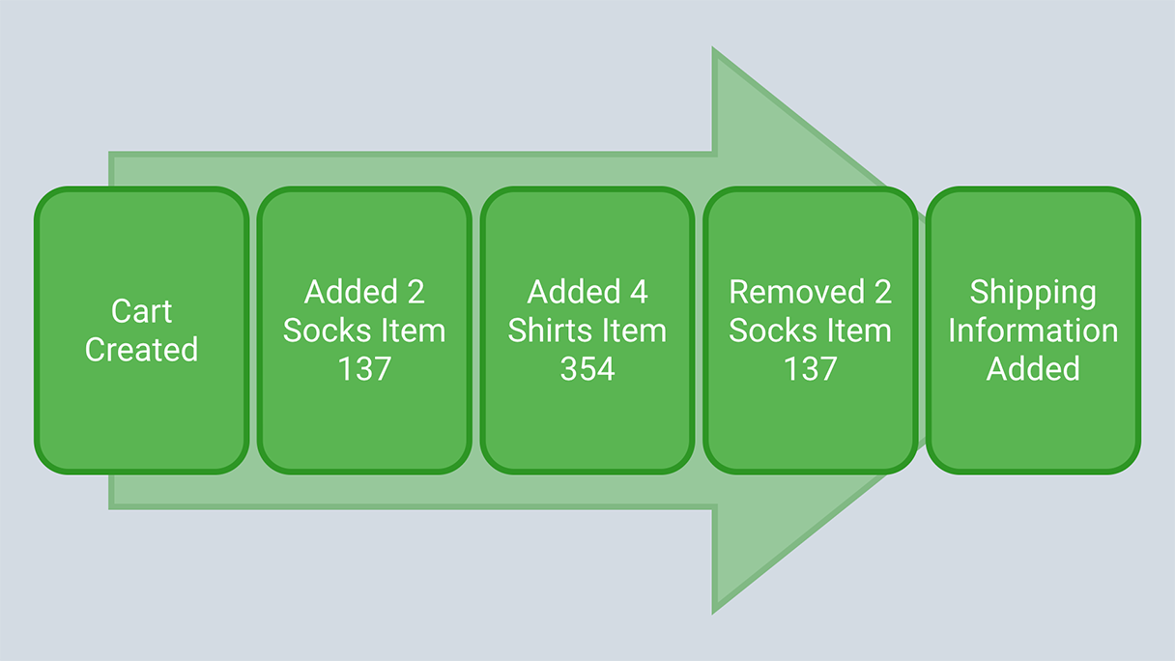
Event Sourcing

Slide 7
Serverless

Slide 8

DB
Web-Server
Feature
Messaging
Monitoring

Slide 9

DB
Web-Server
Feature
Messaging
Monitoring

Slide 10

In Bindings*
Trigger
Out Bindings*

Slide 11
Serverless CQRS
serverless command-handler
PaaS EventStore
serverless projections
PaaS pub/sub
perfect scaling
cloud driven
platform agnostic
technology agnostic

Slide 12
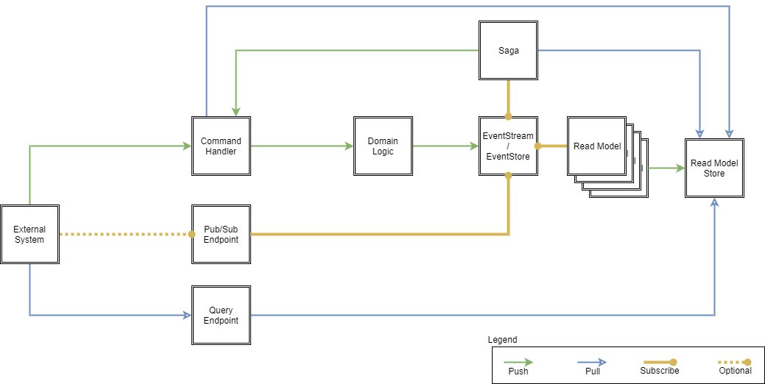
ServerlessCQRS

Slide 13
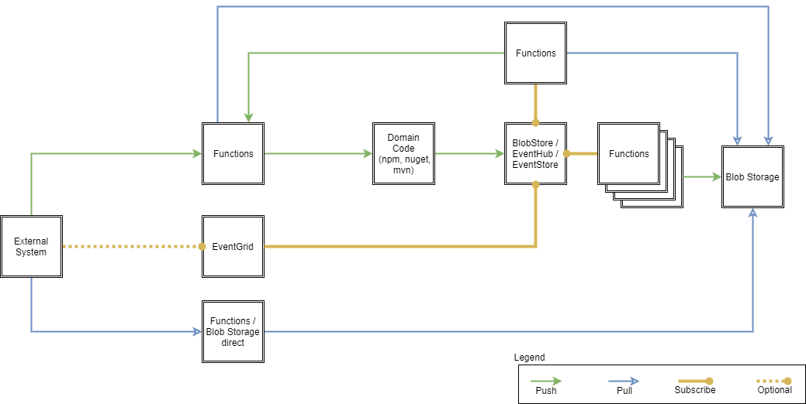
ServerlessCQRS

Slide 14
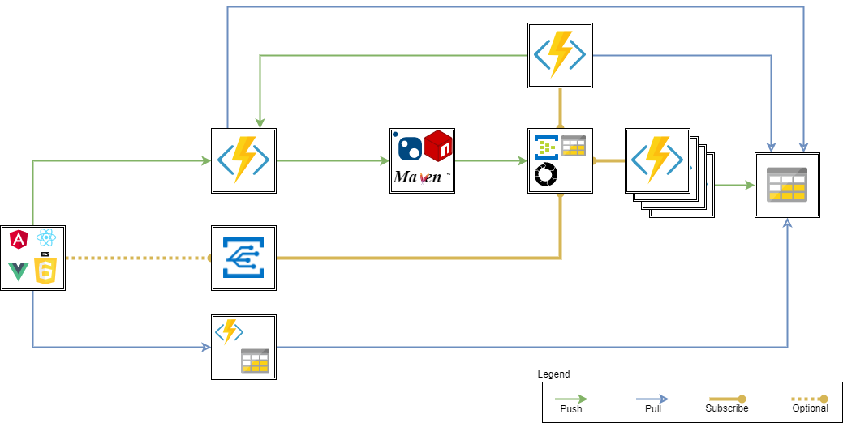
ServerlessCQRS

Slide 15
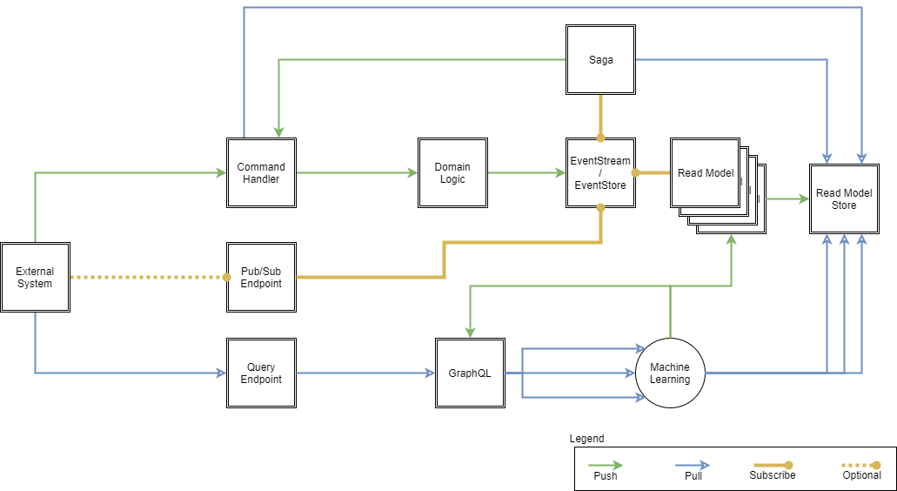
ServerlessCQRS What’s next

Slide 16
Demo

Slide 17
diakuiu
spacibo
xièxie
köszönöm
dziekuje
merci
tak
a dank
dank je wel
gracias
danke
mauruuru
multumesc
kiito
thank you
dekuji
grazie
tack
toda
hvala
tesekkur ederim
go raibh maith agat

Slide 18
Resources
github.com/CQRSaaS – slides, demos -> contribute
github.com/adaptech – original nota code
functionlibrary.azurewebsites.net – Easy ARM Deployments
“Google” – best source for education and information

